Slide 1
LSA DATA ENGINEERING INTERNSHIP · SEPTEMBER 2026
From regulator data
to a launch decision
How four weeks of pipeline work answers one business question for Home Safe, a new home-care provider in Ashford, Kent
Venkat Potamsetti · 17 September 2026
Notes:
Frame: we are not learning pipelines for their own sake. Every step exists because a decision at the end depends on it.

Slide 2
THE BRIEF
One question, asked of 57,127 rows
Home Safe is a business planning to enter the Kent home-care market
Base: TN23 6LN, Ashford — everything is measured from that one point
Catchment: what a carer can reach in about 30 minutes
Everything comes from public CQC data. No inside information
“Where around Ashford can a new home-care provider credibly launch — and where is someone already there?”
57,127
14,470
212
CQC locations in the file
home-care agencies in England
competitors near Ashford
Source: CQC Care Directory, produced 16 September 2026. Contains Care Quality Commission information licensed under the Open Government Licence v3.0.
Notes:
The funnel is the story: a national file, filtered to one service type, then to one catchment.

Slide 3
HOW IT WORKS
The whole process in four steps
1
2
3
4
Extract
›
Transform
›
Load
›
Analyse
Week 1
Week 2
Week 3
Week 4
Get the raw data and
understand what is
actually in it
Clean it, then add what
is missing — here, map
coordinates
Store it so it can be
queried, re-run safely
and scheduled
Answer the question
and make a
recommendation
Each step is boring on its own. Together they turn a file nobody can read into a decision somebody can act on.
Notes:
Ask the room which step they think takes longest. It is usually Transform, not Analyse.

Slide 4
STEP 1
Week 1 — Extract: get the data, then read it properly
The published file has four title rows before the real column headings — skip them, or every column is named wrong
Read everything as text. A postcode is an identifier, not a number: 'CT1 3AA' must never become a float
Filter to one service type: 'Homecare agencies' — the competitor set
Filter to the postcode areas that could possibly reach Ashford: TN, CT, ME
57,127
472
rows in
candidates out
Deliverable: a data dictionary — what each column means and whether you can trust it.
Extract is not 'download the file'. It is knowing exactly what you pulled and what you left behind.
Notes:
The skipped title rows are a real trap: pandas silently names the columns after row 1 and everything downstream fails oddly.

Slide 5
STEP 1 · THE SURPRISE
What the file did not contain
No quality ratings
No registration dates
A different geography
The directory is published under a name that mentions ratings. There is no ratings column in it. We cannot compare competitor quality from this file.
So we cannot see who entered the market and when, or how fast providers come and go.
Local authority here is the county ('Kent'). The CQC API returns districts ('Ashford'). Same regulator, same word, different meaning.
Check the columns you actually have. Never trust the name on the file.
Notes:
This is the single most transferable lesson of Week 1.

Slide 6
STEP 2
Week 2 — Transform: cleaning is where the bugs live
Standardise every postcode: upper case, one space, validated shape
Flag anything odd — never silently drop a row you do not understand
Derive the area (postcode district) each agency sits in
Check for duplicate IDs before anything is counted
A real trap
CT2 8AJ
written without its space becomes CT28AJ.
A clever pattern reads the area as CT28 — a district that does not exist — and quietly moves a Canterbury agency onto a phantom map pin.
The fix: a UK postcode always ends in exactly three characters. Cut those off. Nothing cleverer.
Cleaning rules are decisions. Write them down, and test them — nobody notices a wrong postcode until the map looks strange.
Notes:
Show the failing case in the notebook if there is time.

Slide 7
STEP 2 · GEOCODING
Week 2 — Enrich: a postcode is not a location
TN23 6LN
postcodes.io
51.132, 0.867
→
→
what CQC gives us
free, no sign-up,
100 postcodes per call
what a map and a
distance need
385 competitor postcodes looked up once, then saved to a cache file
Every later run reads the cache — so the notebook works offline and nobody hammers a free public service during a class
3 postcodes came back empty: terminated addresses CQC still lists. Recorded as gaps, not quietly dropped
Enrichment means joining to something you did not have. Cache the answer, and always record what failed to match.
Notes:
Same lesson as the Week 2 Companies House step: cache first, call the network only for misses.

Slide 8
STEP 2 · TESTING
Week 2 — Tests: the two bugs that hid in plain sight
An empty cell is not empty
Nothing is not zero
In Python, a missing value in a spreadsheet column passes an 'is this filled in?' check. The code happily treated blanks as real data.
In SQL, counting a column that is blank everywhere returns 'no answer', not 0. A district with no rated agencies silently showed a gap instead of a zero.
23
Both bugs were found by a test, not by reading the code. Each now has a test of its own, so they cannot come back unnoticed.
automated tests, all passing
Tests run with no internet and no API keys — so they run anywhere, every time, in under a second.
Notes:
The point for beginners: tests are not bureaucracy, they are how you find out you were wrong before a stakeholder does.

Slide 9
STEP 3
Week 3 — Checks that actually stop a bad load
STOPS THE LOAD
RECORDED, BUT LET THROUGH
Duplicate IDs
An agency whose provider is missing
Fewer than 95% of rows mapped to coordinates
A pin that lands outside Great Britain
The row count swinging more than 20% from last time
One or two malformed postcodes
An area outside the expected list
A single row that could not be mapped
Every run — loaded or blocked — leaves a record of what it checked.
The question that decides which list a check belongs in: is stale data worse than wrong data? For a launch decision, wrong is worse.
Notes:
Get the room to argue this one. It is a judgement call, not a technical one.

Slide 10
STEP 3 · THE MODEL
Week 3 — Store it so the question stays answerable
Provider
Date
who owns the branch
which monthly snapshot
One agency, as seen on one date
the fact table
Area
Audit
which postcode district
what each run did
Because the date is part of the key, this month's picture and next month's sit side by side — which is how you see the market moving instead of just its snapshot today.
Notes:
Start with the grain question: what is one row? 'One provider' is the wrong answer.

Slide 11
STEP 3 · SAFE RE-RUNS
Week 3 — Run it twice, get the same answer
The naive way
The safe way
add the rows → 212, then 424
replace that day's rows → 212, then 212
Every competitor counted twice. The map doubles. Nothing warns you — the numbers just quietly become wrong.
Delete this snapshot, insert it again, all in one go. If anything fails halfway, everything is undone — the database is never left half-finished.
Anything that runs on a schedule will run twice one day — a retry, a crash, someone pressing the button. Build for it.
Notes:
This is the single most useful idea in Week 3 and it fits in one sentence.

Slide 12
STEP 3 · SCHEDULING
Week 3 — A notebook is not a pipeline
A scheduler cannot press 'Run all'. It needs a plain script it can run unattended
The script reports how it went, so a failure is visible without anyone reading logs
Windows uses Task Scheduler; Mac and Linux use cron; GitHub Actions runs it in the cloud from any laptop
Whatever runs it must run the whole chain — extract, then transform, then load — in order
0
Loaded
2
Blocked by a check — nothing written
1
Crashed — everything undone
What the script reports back
If nobody would notice the pipeline failing for a week, it is not really scheduled.
Notes:
Mention the Actions catches: secrets, and the runner being thrown away after each run.

Slide 13
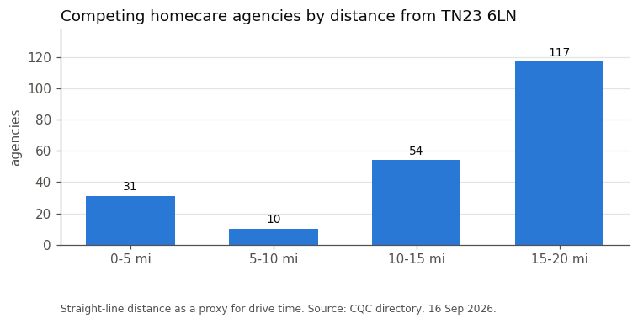
THE ANSWER · 1
Ashford itself is not crowded. Its neighbours are.
212 home-care agencies sit within the catchment
Only 41 of them are within 10 miles of TN23 6LN
Most of the count comes from Maidstone, Medway and Canterbury, out at the edge
An agency 18 miles away competes with you for staff far more than it competes for your client.
Notes:
The doughnut shape is an artefact of area: an outer ring is simply bigger. Say so before someone else does.

Slide 14
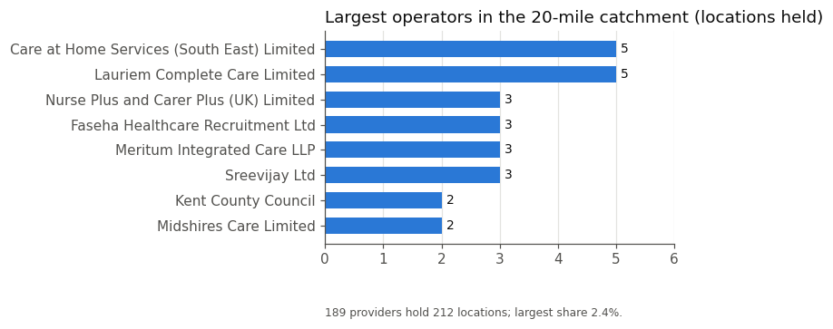
THE ANSWER · 2
No one runs this market
189
5
separate providers
branches held by the biggest
Nearly every competitor is a single-branch operator. There is no chain to displace — and equally, nothing stopping the next small start-up either.
Low barriers cut both ways: easy to enter, easy for the next entrant too. Whatever Home Safe builds has to be hard to copy.
Notes:
If asked about the concentration index: it scores far below the level regulators treat as even moderately concentrated.

Slide 15
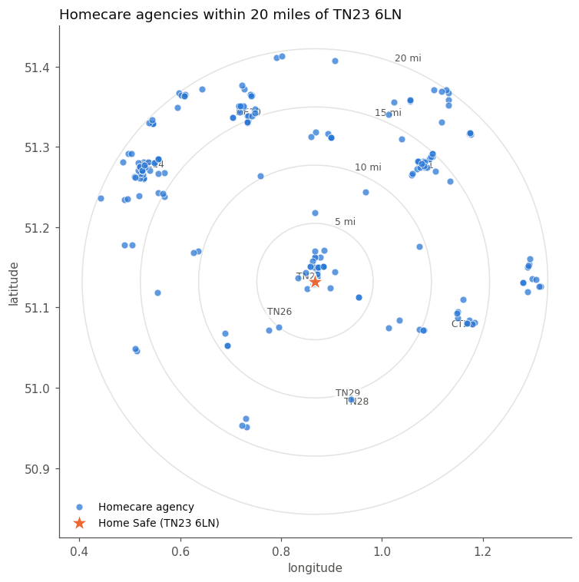
THE ANSWER · 3
Every competitor, plotted
The star is Home Safe's base at TN23 6LN
Rings are 5, 10, 15 and 20 miles
Clusters are towns: Canterbury to the north-east, Maidstone and Medway to the west, Folkestone to the south-east
The 20-mile ring stands in for a 30-minute drive — it is a proxy, not a drive time
An interactive version, where every pin names its provider, is saved alongside the notebook.
Notes:
The proxy caveat matters: the M20 reaches much further in 30 minutes than a lane across the Marsh.

Slide 16
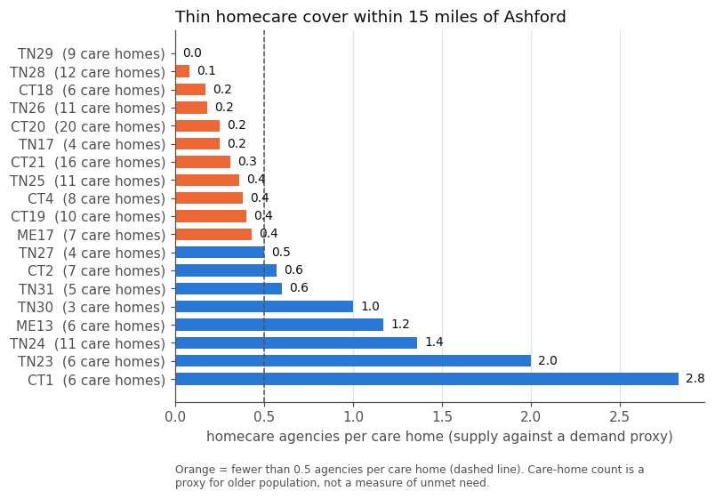
THE ANSWER · 4
Where nobody is based
Supply: home-care agencies based in each area
Demand, roughly: how many care homes are there — a rough sign of where older people live
Romney Marsh has nine care homes and no home-care agency based there. New Romney has twelve and one
Hythe, the Elham villages and the villages towards Tenterden look similar — all inside 12 miles
Careful: this says no agency is BASED there, not that nobody serves it. A hypothesis to check, not a finding.
Notes:
CQC registers an office, not a territory. Say this twice.

Slide 17
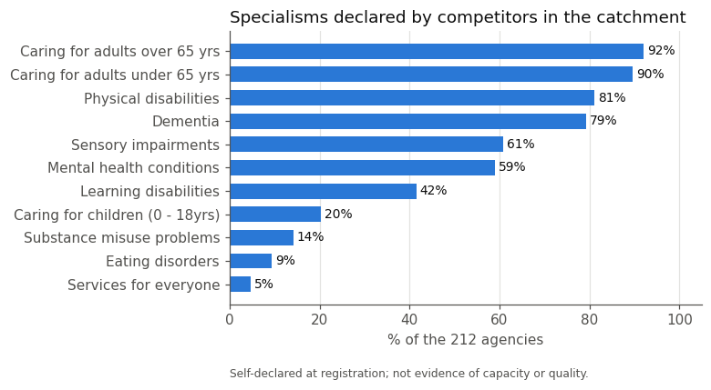
THE ANSWER · 5
Competitors all say the same thing
92%
79%
say older adults
say dementia
42%
40%
say learning disability
list no website at all
Saying 'we do dementia care' says nothing a family has not read two hundred times. The thinner specialisms are the defensible ones.
Notes:
Specialisms are self-declared at registration, so they show positioning, not proven capability.

Slide 18
THE RECOMMENDATION
What we would tell Home Safe
1
Base in Ashford, build the rounds south
2
Check the gap before committing
Ashford town is contested; the rural belt within 12 miles is not.
A week of calls: the council's provider list, five care homes, two GP practices.
3
Pick a specialism, not a slogan
4
Treat the website as infrastructure
Learning disability, complex or children's work — fewer rivals, better rates.
Two in five competitors have none. Self-funding families search before they phone.
5
Model staff travel time first
6
Re-run this monthly
189 providers recruit from the same pool. Tight village rounds win; scattered ones lose money.
Barriers are low both ways. Watch who registers next in the target areas.
The binding constraint is not competition for clients. It is staff, travel time and access to council contracts.
Notes:
Recommendation 2 is the honest one: we are handing over a hypothesis with a way to test it.

Slide 19
HONESTY
What this analysis cannot tell you
A registered address is not a service area
Ask the council; call providers
'Nobody based there' is not 'nobody serving there'.
A straight line is not a drive
Use a real drive-time map
The motorway reaches further than a country lane in 30 minutes.
No ratings in this file
Pull ratings from the CQC API
We cannot say who is good and who is struggling.
Care homes stand in for population
Use ONS population aged 65+
A rough proxy for where older people live, nothing more.
Saying what you do not know is part of the deliverable. A stakeholder who finds the gap later stops trusting the parts that were right.
Notes:
This slide is the one that earns trust. Do not skip it for time.

Slide 20
The point of the pipeline
Next month's file lands.
You run one command.
The answer updates.
That is the difference between an analysis and a pipeline.
Everything in this deck is in the notebook: the code, the 23 tests, the cached coordinates, the map and the write-up.
HomeSafe_Ashford_Market_Analysis.ipynb · September_2026 / Week_4
Notes:
Close by inviting them to change one assumption — the 20-mile ring — and see whether the recommendation survives.

